Slide 1
Functions
Course Code: CSC 1204
Course Title: Discrete Mathematics
Dept. of Computer Science
Faculty of Science and Technology
Lecturer No: | 5 | Week No: | 3 | Semester:
Lecturer: | Name & email

Slide 2
Lecture Outline
2.3 Functions
Definition of Function
Domain, Codomain, Range, Image, Preimage,
One-to-one function
Onto function
One-to-one correspondence
Inverse Functions
Compositions of Functions
    Floor function
    Ceiling Function

Slide 3
Objectives and Outcomes
Objectives: To understand what is function, domain, codomain, range, image, preimage; to understand different types of functions.
Outcomes: Students are expected to be able to explain different types of functions with examples, be able to determine whether a function is one-to-one, onto, and/or one-to-one correspondence, be able to determine whether a function is invertible and find out the inverse of a function, be able to apply floor and ceiling functions.

Slide 4
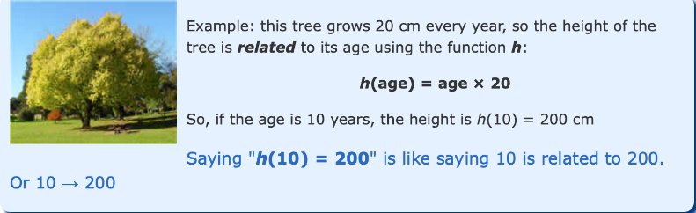
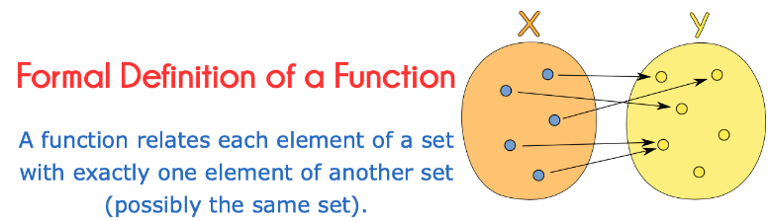
Functions
A function relates an input to an output. Function is defined in terms of sets
Functions can be defined in many ways

Slide 5
Functions
Definition 1: Let A and B be nonempty sets.
A function f from A to B is an assignment of exactly one element of B to each element of A.
We write f(a) = b if b is the unique element of B assigned by the function f to the element a of A.
If f is a function from A to B, we write f: A→B
Note: Functions are sometimes called mappings or transformations.

Slide 6
Functions
Functions are specified in many ways.
Sometimes we explicitly state the assignments, as in Figure 1.
Often, we give a formula, such as f(x) = x + 1, to define a function.
Other times we use a computer program to specify a function.

Slide 7
Functions
A function f: A→ B can also be defined in terms of a relation from A to B. [we will cover Relation in final term]
A relation from A to B is just a subset of A X B.
A relation from A to B that contains one, and only one, ordered pair (a, b) for every element a∈ A, defines a function f from A to B. This function is defined by the assignment f(a)=b, where ( a, b) is the unique ordered pair in the relation that has a as its first element.

Slide 8
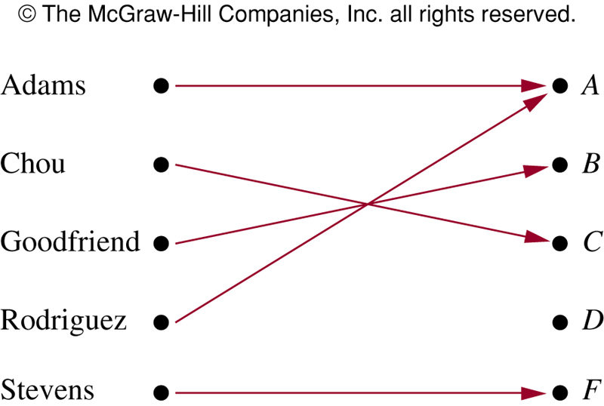
FIGURE 1: Assignment of Grades in a
Discrete Mathematics Class

Slide 9
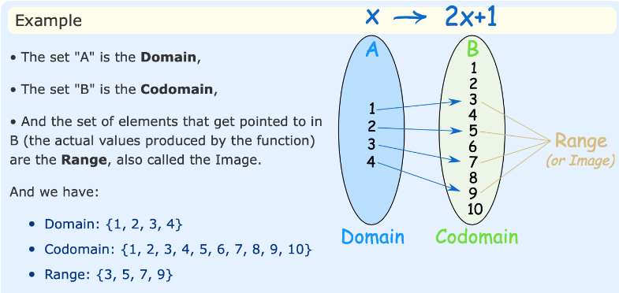
Domain, Codomain and Range
What can go into a function is called the Domain
What may possibly come out of a function is called the Codomain
What actually comes out of a function is called the Range
The Range is a subset of the Codomain.

Slide 10
Some Function Terminology
Definition 2: If f is a function from A to B, we say that A is the domain of f and B is the codomain of f.
  If f(a)=b, a is the preimage of b and b is the image of a.
  Range of f is the set of all images of elements of A.
  Also, if f is a function from A to B, we say that f maps from A to B.

Slide 11
Domain, Codomain and Range
  If f is a function from A to B, we write f: A→ B
    A is the domain of f
    B is the codomain of f
    If f(a)=b,
        a is called the preimage of b
        b is called the image of a
  Range of f : the set of all images of elements of A

Slide 12
Range versus Codomain
The range of a function might not be its whole codomain.
The codomain is the set that the function is declared to map all domain values into.
The range is the particular set of values in the codomain the function actually maps elements of the domain to.

Slide 13
Range versus Codomain: Example
(See the FIGURE 1 in the previous slide)
Suppose I declare to you that: “f is a function mapping students in this class to the set of grades {A, B, C,D,F}”.
At this point, you know f’s codomain is: {A, B, C,D,F}, and it’s range is unknown!
Suppose the grades turn out all As and Bs.
Then the range of f is {A, B}”, but it’s codomain is still
{A, B, C,D,F}.

Slide 14
Example 1
What are the domain, codomain, and range of the function that assigns grades to students of Discrete Math class as follows?

Slide 15
Solution of Example 1
Solution:
Let G be the function that assigns grade to a student of Discrete Mathematics class.
The domain of G is the set { Adams, Chou, Goodfriend, Rodriguez, Stevens}
The codomain of G is the set { A, B, C, D, F}
The range of G is the set { A, B, C, F}
    Because each grade except D is assigned to some student

Slide 16
Example 2
Let R be the relation consisting of ordered pairs (Abdul, 22), (Brenda,24), (Carla,21), (Desire,22), (Eddie,24), and (Felicia,22), where each pair consists of a graduate student and the age of this student. What is the function that this relation determines?
Solution: This relation defines the function f, where with f(Abdul)= 22, f(Brenda)=24, f(Carla)=21, f(Desire)=22, f(Eddie)= 24, and f(Felicia)=22.
Here, domain is the set { Abdul, Brenda, Carla, Desire, Eddie, Felicia }
To define the function f, we need to specify a codomain. Here, we can take the codomain to be the set of positive integers
Range is the set {21,22,24}

Slide 17
Functions
Definition 3: Let f₁ and f₂ be functions from A to R. Then
f₁+ f₂ and f₁ f₂ are also functions from A to R defined by
  (f₁+ f₂)(x) = f₁(x) + f₂(x)
  (f₁ f₂)(x) = f₁(x) f₂(x)

Slide 18
Example 6
Let f₁ and f₂ be functions from R to R such that f₁(x)=x² and f₂(x)=x – x². What are the functions f₁ + f₂ and f₁ f₂ ?
  Solution:
    (f₁ + f₂)(x) = f₁(x) + f₂(x) = x² + (x –x² ) = x
    (f₁f₂)(x) = x²(x− x² ) = x³ – x⁴

Slide 19
Functions
Definition 4: Let f be a function from the set A to the set B, and let S is a subset of A. The image of S under the function f is the subset of B that consists of the images of the elements of S.
We denote the image of S by f(S).
f(S) = {t|∃s∈S(t=f(s))}

Slide 20
Example 7
Let A = {a, b, c, d, e} and B = {1, 2, 3, 4} with f(a) = 2,
f(b) = 1, f(c) = 4, f(d) = 1, f(e) = 1.
What is the image of the subset S = {b, c, d}?
Solution:
The image of the subset S = {b, c, d} is the set
f(S) = {1, 4}

Slide 21
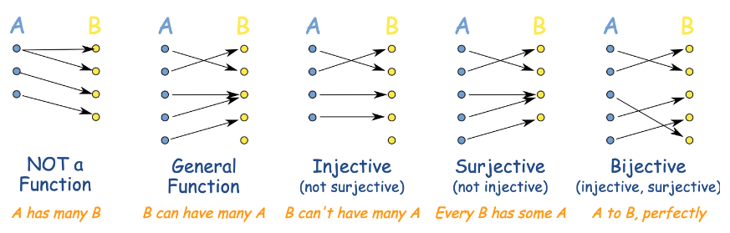
One-to-One Functions
A function is a way of matching the members of a set "A" to a set "B”. "Injective, Surjective and Bijective" tells us about how a function behaves.
A General Function points from each member of "A" to a member of "B".
It never has one "A" pointing to more than one "B", so one-to-many is not OK in a function (so something like "f(x) = 7 or 9" is not allowed)
But more than one "A" can point to the same "B" (many-to-one is OK)

Slide 22


One-to-One Functions
Injective means we won't have two or more "A"s pointing to the same "B". Injective is also called "One-to-One"
So many-to-one is NOT OK (which is OK for a general function). As it is also a function one-to-many is not OK. But we can have a "B" without a matching "A”.
Surjective means that every "B" has at least one matching "A" (maybe more than one).
There won't be a "B" left out.
Bijective means both Injective and Surjective together.
Think of it as a "perfect pairing" between the sets: every one has a partner and no one is left out. So there is a perfect "one-to-one correspondence" between the members of the sets.
(But don't get that confused with the term "One-to-One" used to mean injective).

Slide 23
One-to-One Functions
Definition 5: A function f is one-to-one or injective, iff f(a) = f(b) implies that a = b for all a and b in the domain of f.
A function f: A→ B is said to be one-to-one if all the elements in the domain A have distinct images.
    We can express that f is one-to-one Using quantifiers as ∀a∀b ( f(a) = f(b) → a = b ), or equivalently,
    ∀a∀b ( a ≠ b → f(a) ≠ f(b) ), where the universe of discourse is the domain of the function f

Slide 24
Example 8
Determine whether the function f from {a, b, c, d} to {1, 2, 3, 4, 5} with f(a)=4, f(b)=5, f(c)= 1, and f(d)=3
is one-to-one.
Solution: The function is one-to-one because every element of domain has a distinct image.
  The function f is one-to-one because f takes on different values at the four elements of its domain.

Slide 25
Example 9
Example 9: Determine whether the function f(x) = x² from the set of integers to the set of integers is one-to-one.
Solution: The function f(x) = x² is not one-to-one because, for instance, f(1)= f(–1) = 1, but 1 = – 1
(i.e. 1 and –1 have same image 1)

Slide 26
Class Work
Determine whether the function f(x) = x² from the set of positive integers to the set of positive integers is one-to-one.
For example, the function f(x) = x + 1 is a one-to-one function because it produces a different answer for every input.
The function f(x) = x^2, on the other hand, is not a one-to-one function because it gives you the same answer for more than one input.

Slide 27
Example 10
Determine whether the function f(x) = x + 1 from the set of real numbers to the set of real numbers is one-to-one.
Solution: The function f(x) = x + 1 is a one-to-one function. Since x + 1 = y + 1, when x = y
For any real number x, there is a distinct image, just 1 bigger than x; so, the function is one-to-one.

Slide 28
Example : One-to-one function
Let A = {1, 2, 3} and B = {a, b, c, d}, and let f(1) = a, f(2) = b, f(3) = d. Then f is injective, since the different elements 1, 2, 3 in A are assigned to the different elements a, c, d respectively in B
Note: Every element of domain has a distinct image. So, the function is one-to-one.

Slide 29
Onto Function
Definition 7: A function f from A to B is onto or surjective, iff for every element b∈B there is an element a∈A with f(a) = b.
A function f: A→B is said to be an onto function if each element of B is the image of some element of A
  i.e., if B = range of f
Note: A function is onto if every element of codomain has preimage(s).

Slide 30
Example 11
Let f be the function from {a, b, c, d} to {1, 2, 3} defined by f(a)=3, f(b)=2, f(c)=1, and f(d)=3. Is f an onto?
[see Figure on next slide]
Solution: Because all three elements of the codomain are images of elements in the domain, f is onto.

Slide 31
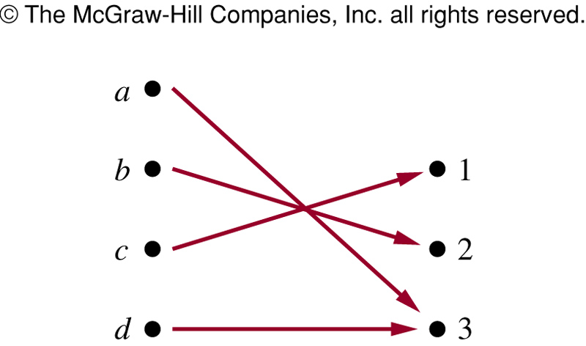
FIGURE for Example 11:
An Onto Function

Slide 32
Example 12
Is the function f(x) = x² from the set of integers to the set of integers onto?
Solution: The function f is not onto, because there is no integer x with x² = –1, for instance.
Note: The elements of the codomain that are negative integers (− 1, − 2, − 3 etc.) do not have any preimage.

Slide 33
Class Work
Is the function f(x) = x² from the set of positive integers to the set of positive integers onto?

Slide 34
One-to-one correspondence (bijection )
Definition 8: A function f is a one-to-one correspondence or a bijection if it is both one-to-one and onto.
Example: Let f be the function from A to B where A={1, 2, 3, 4} and B = {a, b, c, d} with f(1)=d, f(2)=b, f(3)=c, and f(4)=a, then f is bijective function.
    f is one-to-one since the every element of domain has a distinct image
    f is onto since every element of B is the image of some element in A.
    − Hence f is a bijective function (or, one-to-one correspondence)
Practice yourself: Example 14

Slide 35
Books
Discrete Mathematics and its applications with combinatorics and graph theory (7th edition) by Kenneth H. Rosen [Indian Adaptation by KAMALA KRITHIVASAN], published by McGraw-Hill

Slide 36
References
Discrete Mathematics, Richard Johnsonbaugh, Pearson education, Inc.
Discrete Mathematical Structures, Bernard Kolman, Robert C. Busby, Sharon Ross, Prentice-Hall, Inc.
SCHAUM’S outlines Discrete Mathematics(2nd edition), by Seymour Lipschutz, Marc Lipson

